Slide 1

Progress Presentation
20-11-2024
Prepared by: Marie Joe Sawma To: Dr. Reed Maxwell

Slide 2
Objective
The objective is to match the simulated data to the observed data by varying parameters and building the prior distribution. Today, the focus is on hydraulic conductivity and its alignment with the observed data.

Slide 3
Part 1: Explanation of Approach

Slide 4
Collection of Data
Data was collected over a one-year period, starting on October 10, 2018, and ending on October 10, 2019, in the state of Nebraska. The AmeriFlux site for this data is US-Ne2.

Slide 5
Single Column : USNe -2
A specific prior distribution has been assigned to the USNE-2 location. Each location has unique characteristics and, therefore, its own prior distribution.

Slide 6
USNe 2 : Prior Distribution
The prior distribution for the following parameters will be determined :
Hydraulic Conductivity
Porosity
Water Table Depth
Soil Type
Soil Moisture

Slide 7
US Ne2 : Hydraulic Conductivity
A sensitivity analysis has been conducted to assess the influence of the hydraulic conductivity on the simulated latent heat and how its variations leads to matching the observation data collected from Ameri flux.

Slide 8
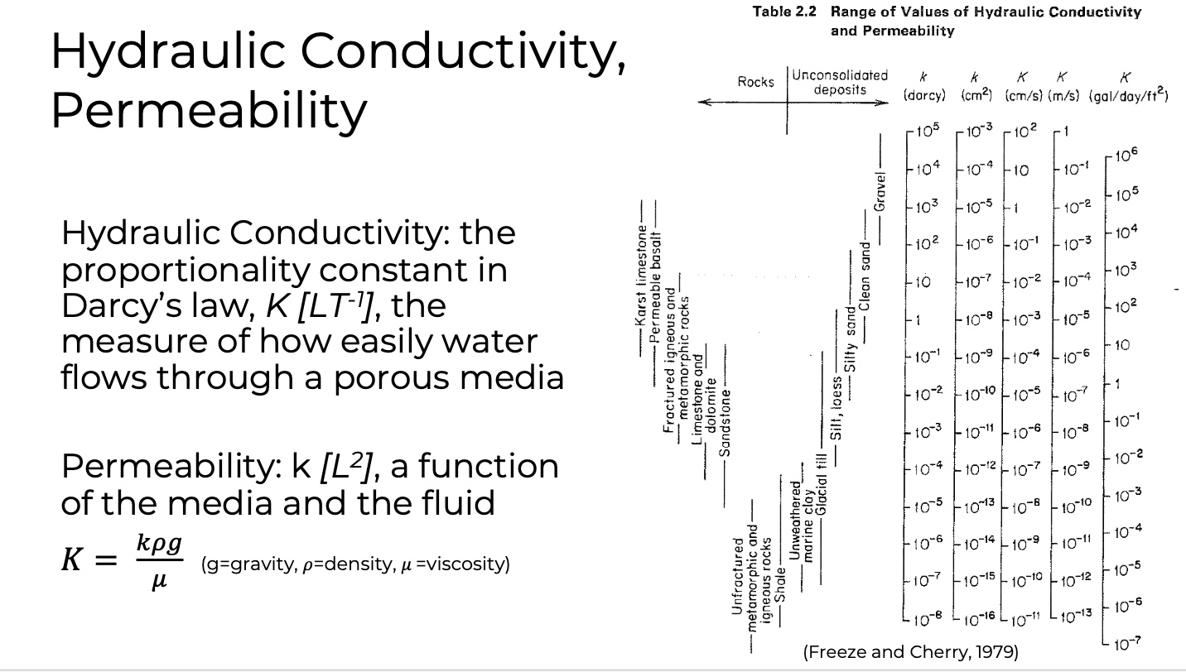
US Ne2 : Hydraulic Conductivity
The Hydraulic Conductivity that have been selected to run the simulations range between 10⁻¹³ and 1 m/s
The objective of running simulation on this big range is to assess the trend of the whole possible hydraulic conductivity through plotting . Moreover, the hydraulic conductivity with high values of error will be eliminated for the next round of simulation that will be more focusing on the range where the value of error are acceptable.

Slide 9

US-Ne2 : Simulation
Running 100 simulation using linear spacing:
K spacing = $\frac{(k\max{−Kmin)}}{100}$

Slide 10
US Ne2 : RMSE Test
The root mean square error test provides a single value that represents the difference in magnitude of the latent heat between the simulated and the observation in a one single value for each hydraulic conductivity. Moreover, it represents the trends or the pattern of error association with each k in our case.

Slide 11
Part 2: methodology

Slide 12
Methodology
Running Simulation
Read The Data from the file
Filtering the data
Apply RMSE
Plotting
Running another Simulation

Slide 13
Part 2 :Coding Functions

Slide 14
Coding: Functions
Observation function
Parflow_clm function
Percentage error function
Filtering function
Rmse function
Loop to go over the simulations

Slide 15
Part 3: Plotting

Slide 16
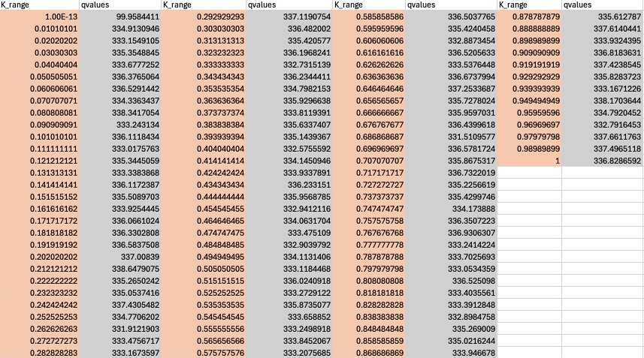
Range of Error For The Broad Range of K
Lower Bound : 99.958 (rmse)
Upper Bound : 336.828 (rmse)
Kmin = 1.00E-13
Kmax = 1

Slide 17
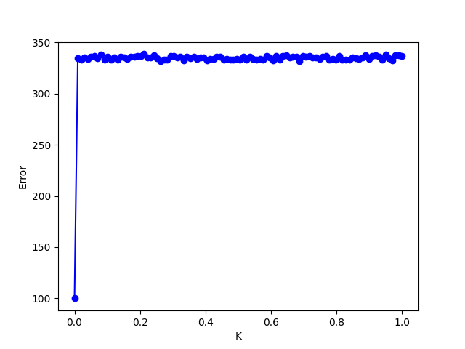
Plotting and Trend
Focus on the hydraulic conductivity values between 1.00E-13 and 0.01, as a pattern can be observed in this range of the graph while eliminate the other value when re-running the next simulation.

Slide 18
Proposed Approach
Focus on the hydraulic conductivity values between 1.00E-13 and 0.01, as a pattern can be observed in this range of the graph.
Divide this range into smaller intervals, as it is still quite large, and run 100 simulations for each interval.
Calculate the root mean square error (RMSE) for each interval. The prior distribution can then be plotted using the RMSE values.

Slide 19
Next Week
Prior Distribution for k
Prior Distribution for porosity
Prior distribution for vegetation (soil type)
Prior Distribution for water table depth
If there is anything else should I work on it ?
Amanda’s meeting
Extension for my homework 7

Slide 20
Thank you

